Slide 1
Amazon Dashboard
Created by – Jay Prakash tool name - Excel

Slide 2
Content
E-Commerce
E-Commerce dashboard
Used Tool for DashBoard
KPI of E-Commerce Dashboard

Slide 3
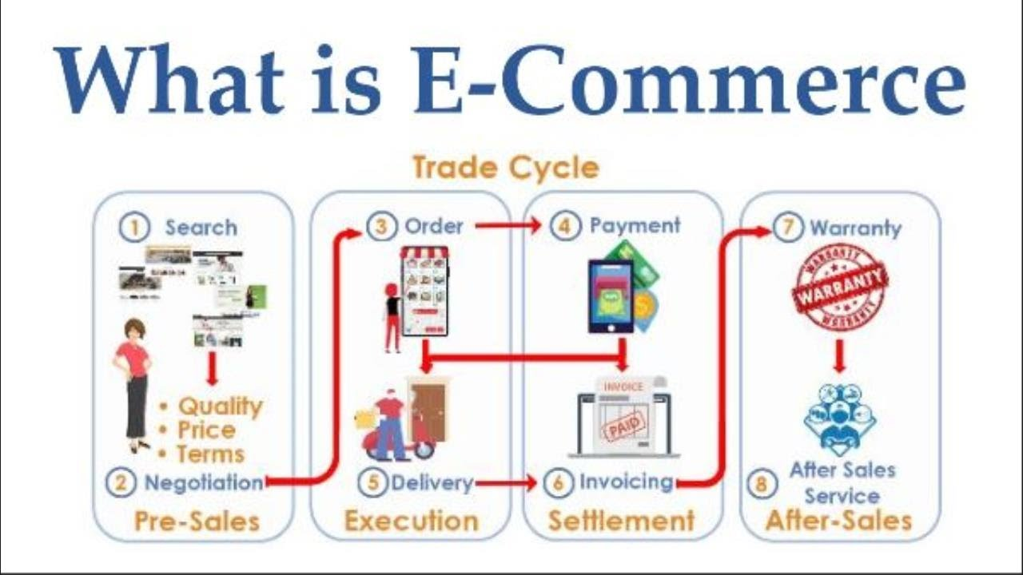
E-Commerce
E-commerce (electronic commerce) is the buying and selling of goods and services, or the transmitting of funds or data, over an electronic network, primarily the internet. These business transactions occur either as business-to-business (B2B), business-to-consumer (B2C), consumer-to-consumer or consumer-to-business.

Slide 4
E-Commerce dashboard
An ecommerce dashboard is a curated set of metrics, KPIs and other data that's designed to highlight, in the clearest possible way, trends, anomalies and information related to an online store that regularly warrants attention.

Slide 5
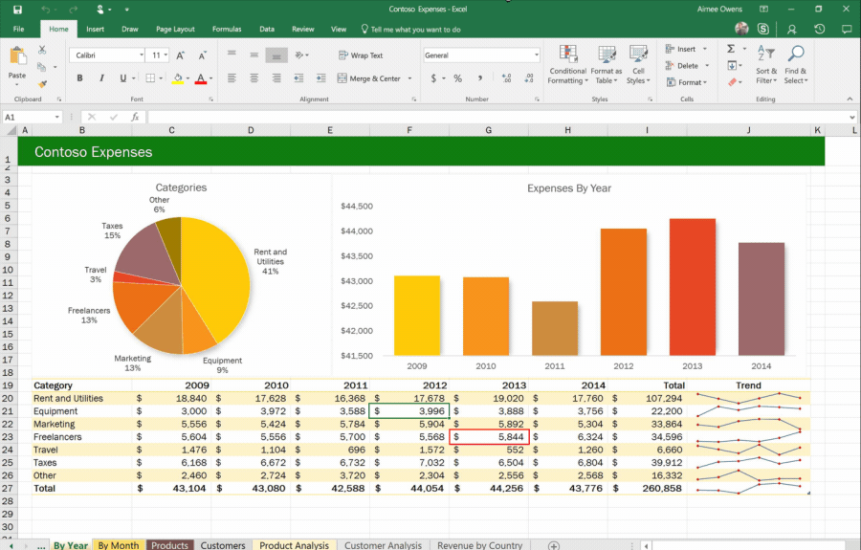
Used Tool for DashBoard
Microsoft Excel
Microsoft Excel is a spreadsheet developed by Microsoft for Windows, macOS, Android and iOS. It features calculation or computation capabilities, graphing tools, pivot tables, and a macro programming language called Visual Basic for Applications. Excel forms part of the Microsoft Office suite of software

Slide 6
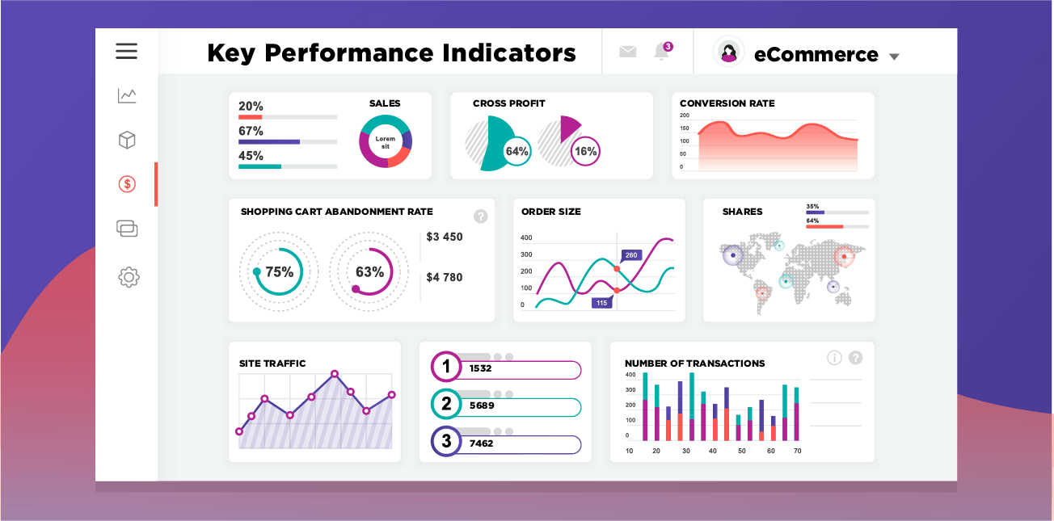
KPI of E-Commerce Dashboard
A dashboard in eCommerce is a collection of key performance indicators (KPIs) that allow business owners and managers to track the progress of their online stores. By having access to this data, they can make informed decisions about what changes need to be made in order to improve their business.

Slide 7
1. KPI of E-Commerce Dashboard

Slide 8
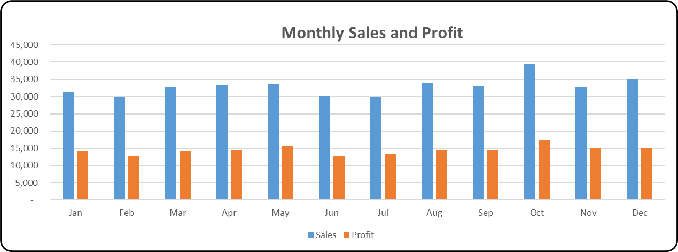
2. KPI of E-Commerce Dashboard

Slide 9
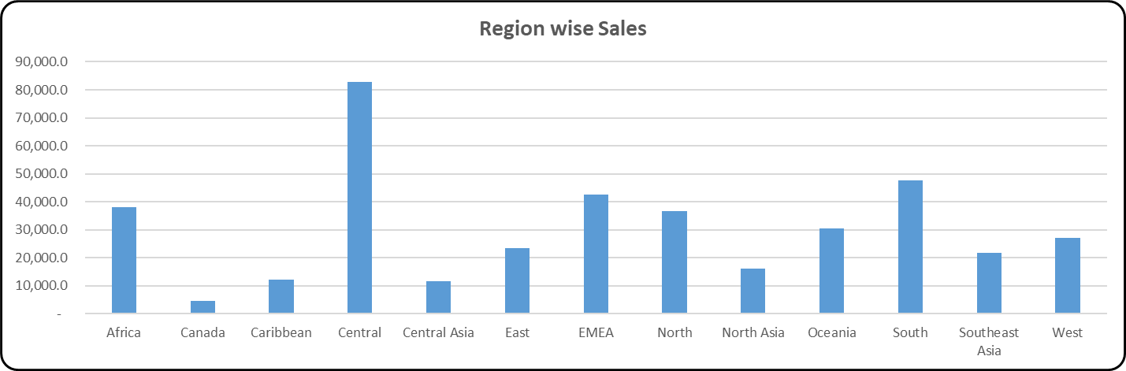
3. KPI of E-Commerce Dashboard

